Slide 1
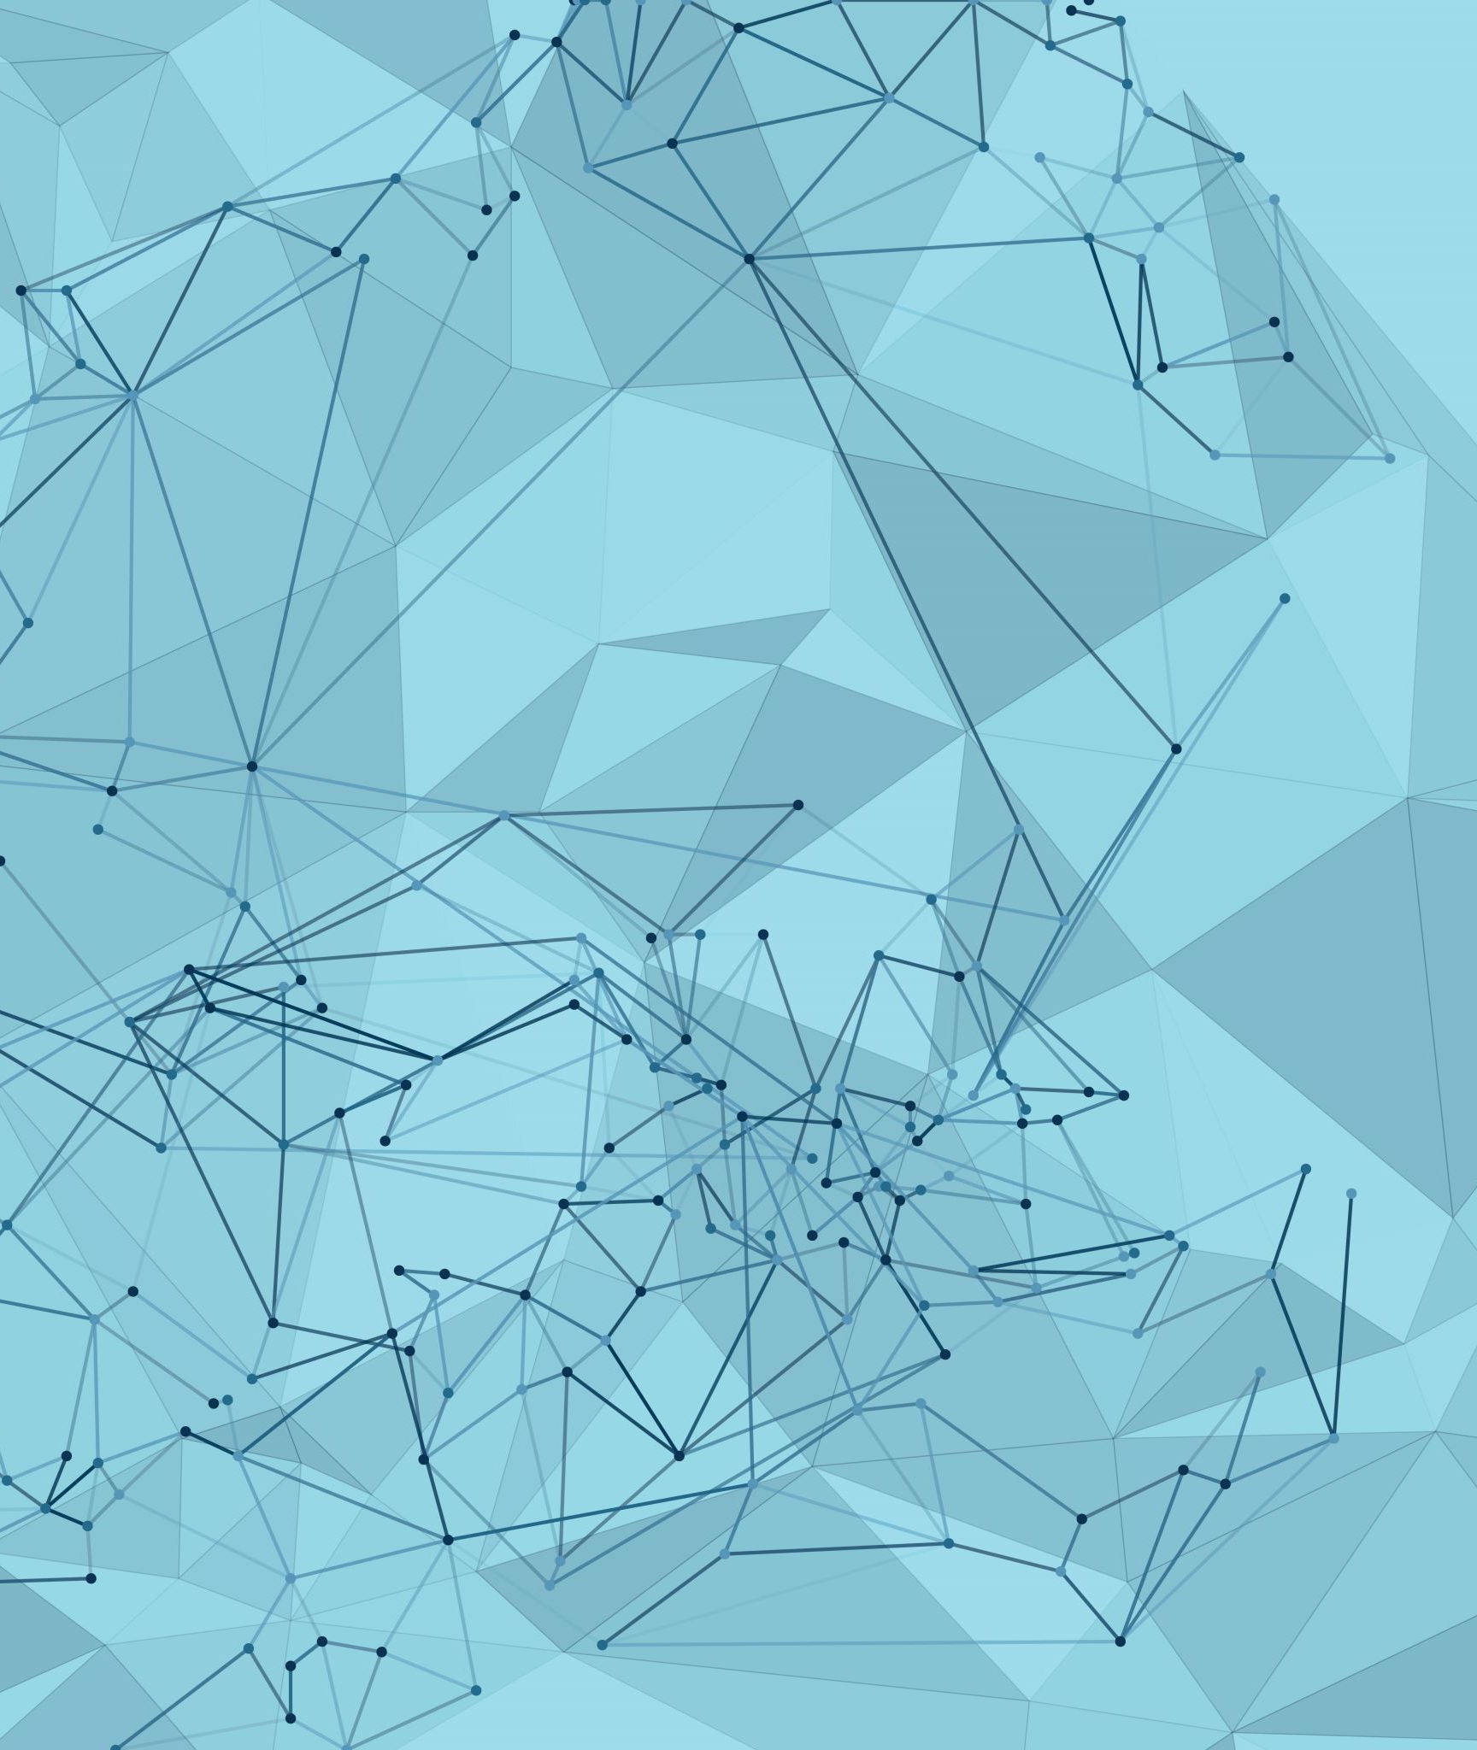
Reinforcement Learning
By: Kent & Yu Jie

Slide 2
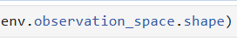
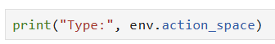
EDA
Observation Space Analysis
Shape of 3 tell us that the environment is a vector of 3 numbers
First Value and Second Value (cos(θ) and sin(θ))
Third value is the angular velocity
2) Action Space Analysis
-2.0 and 2.0: These are the minimum and maximum possible values for the action.
(1,): This is the shape of the action vector, indicating it's a single-dimensional vector.
3) Reward Structure
Penalty for Angle: θ^2
Penalty for Angular Velocity: 0.1 x θ(dot)^2
Penalty for Torque: 0.001⋅τ^2

Slide 3
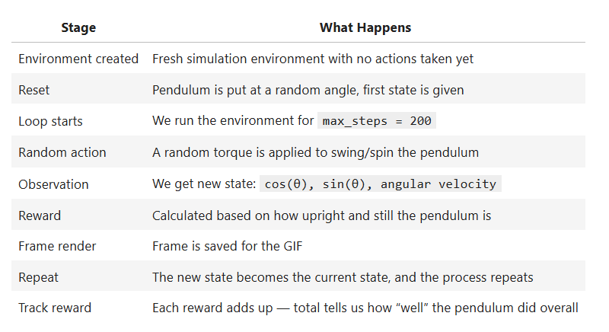
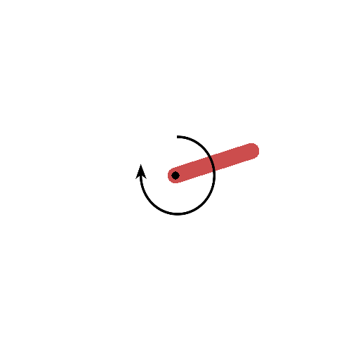
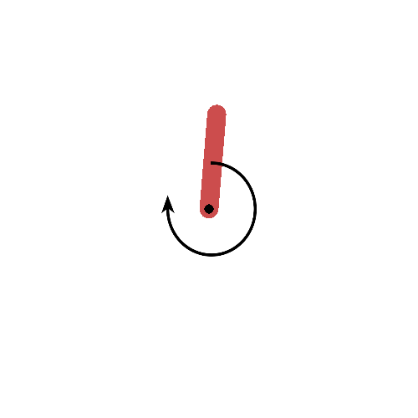
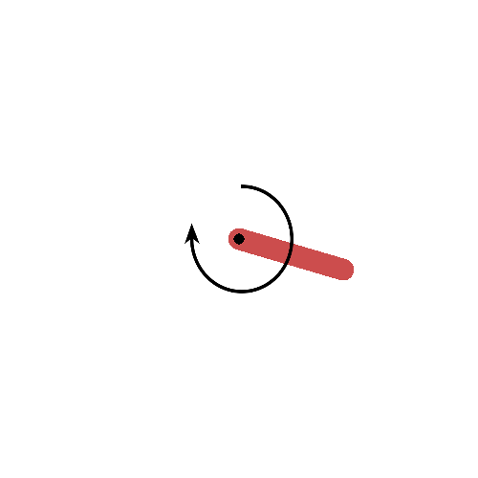
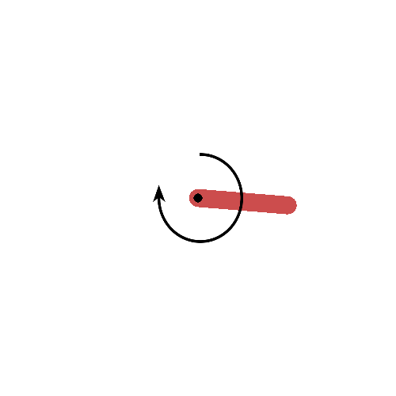
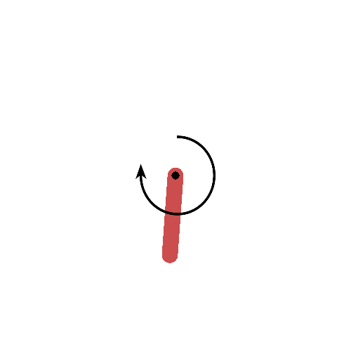
EDA (2)
4) Visualing the environment
Action (-2)
Action (-1)
Action (1)
Action (2)

Slide 4
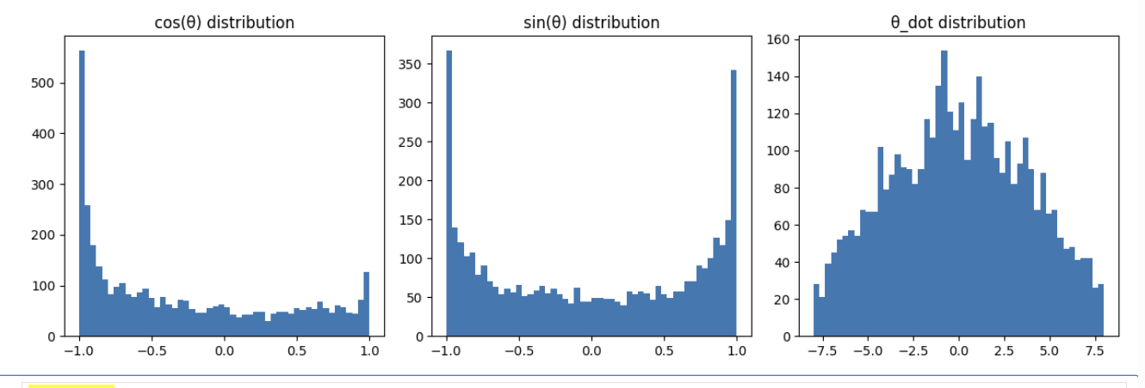
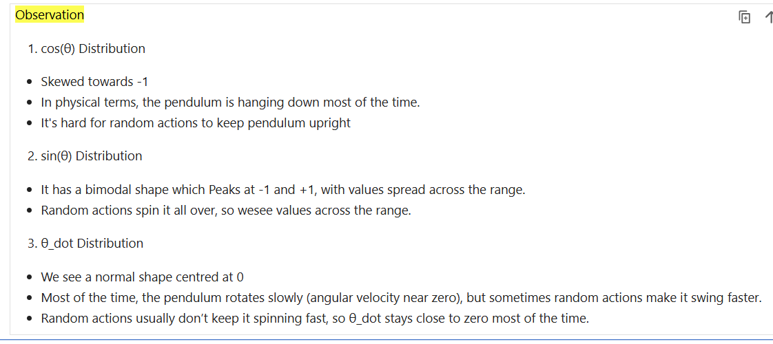
EDA (3)
5) Observation Value Distribution

Slide 5
How to determine best model?
1. Mean Reward
This is the primary metric. The mean reward (or average return) over a set of evaluation episodes tells the agent's average performance with a greedy policy (no exploration)
2. Reward Variance
This metric measures the consistency of the agent's performance.
3. Training vs. Evaluation Comparison
Comparison between training and evaluation performance. A significant difference can reveal if the agent has overfitted to a specific training environment or if its learned policy performs better without the noise of exploration.

Slide 6
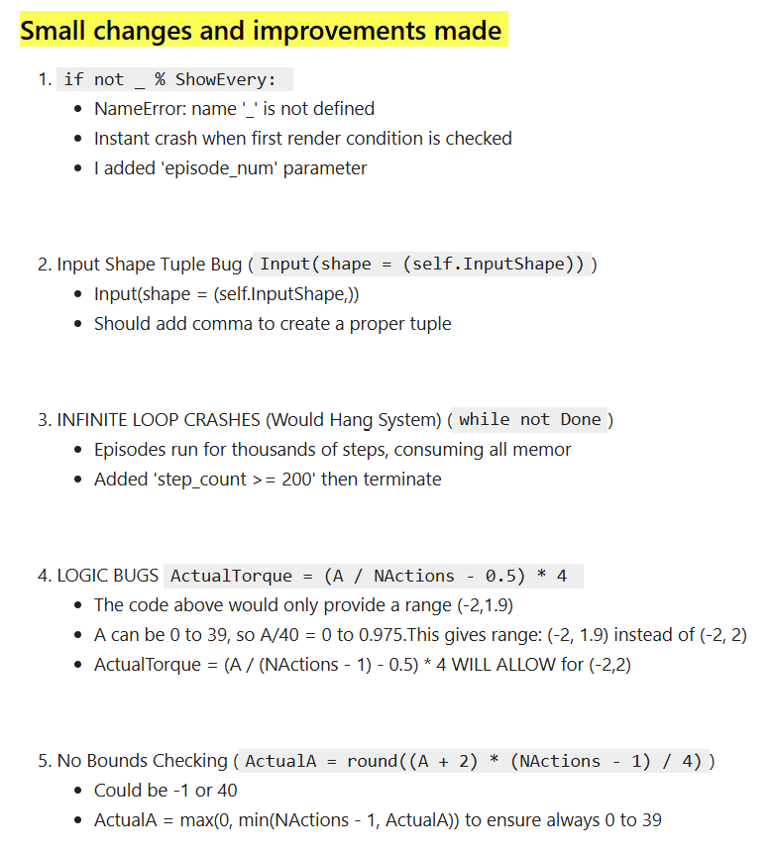
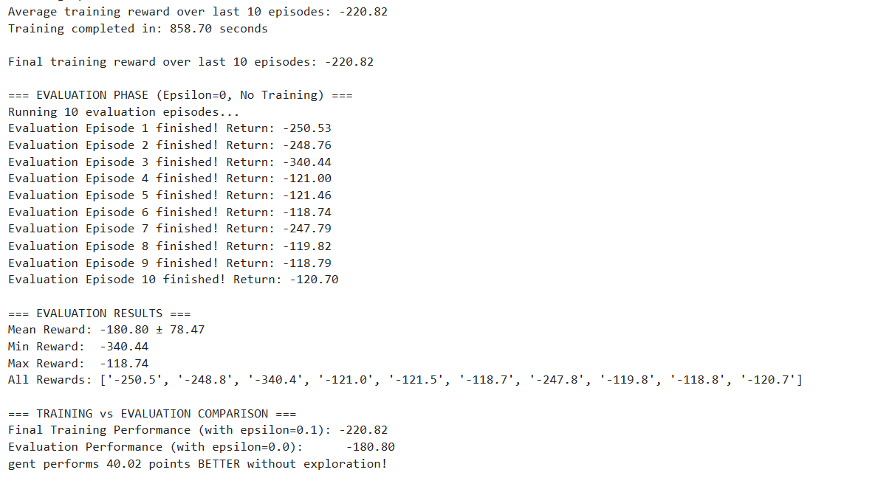
Practical codes (improved)
While the improved teacher's code showed that epsilon=0 improves performance (+40.02 points), the substantial variance (±78.47) and inconsistent results (-340.4 to -118.7) suggest that the fixed choice of 40 discrete actions may not be optimal.

Slide 7
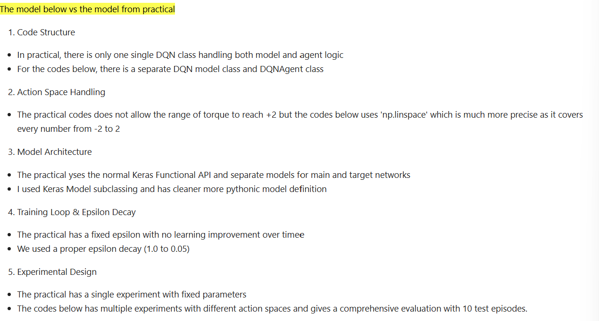
Limitations to codes provided:
Fixed N_ACTIONS = 40 (arbitrary choice)
Manual action conversion formulas (error-prone)
No systematic comparison of action granularities
High performance variance suggests suboptimal discretization

Slide 8
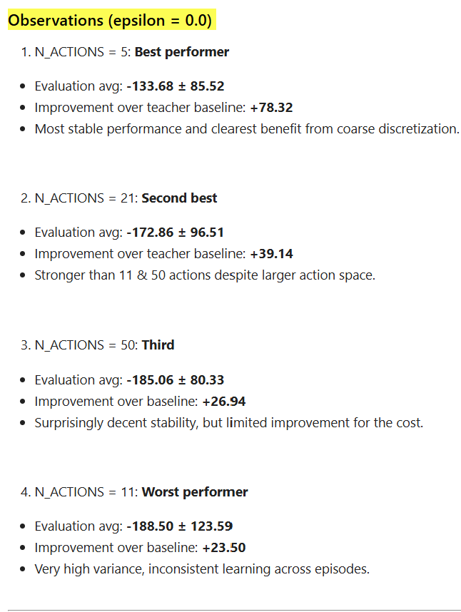
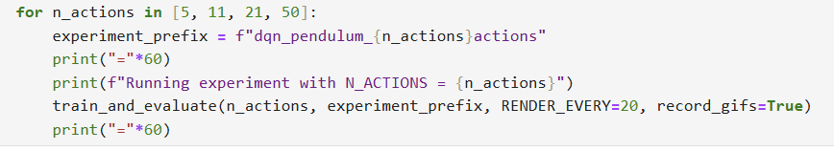
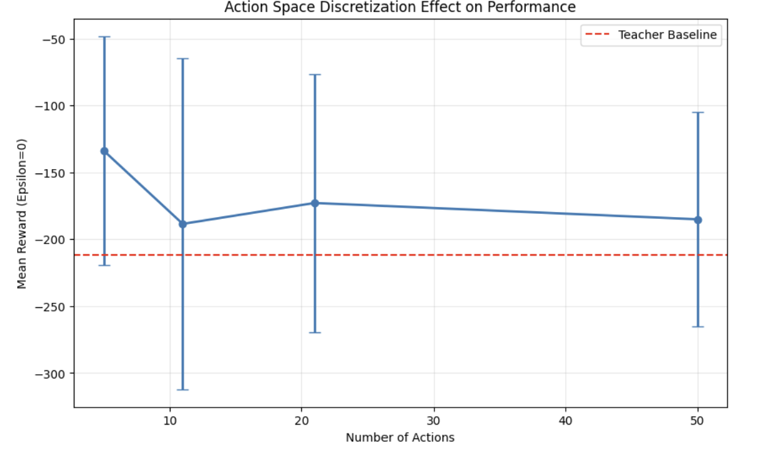
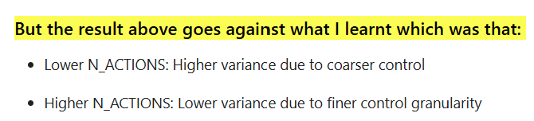
N_Actions Exploration

Slide 9
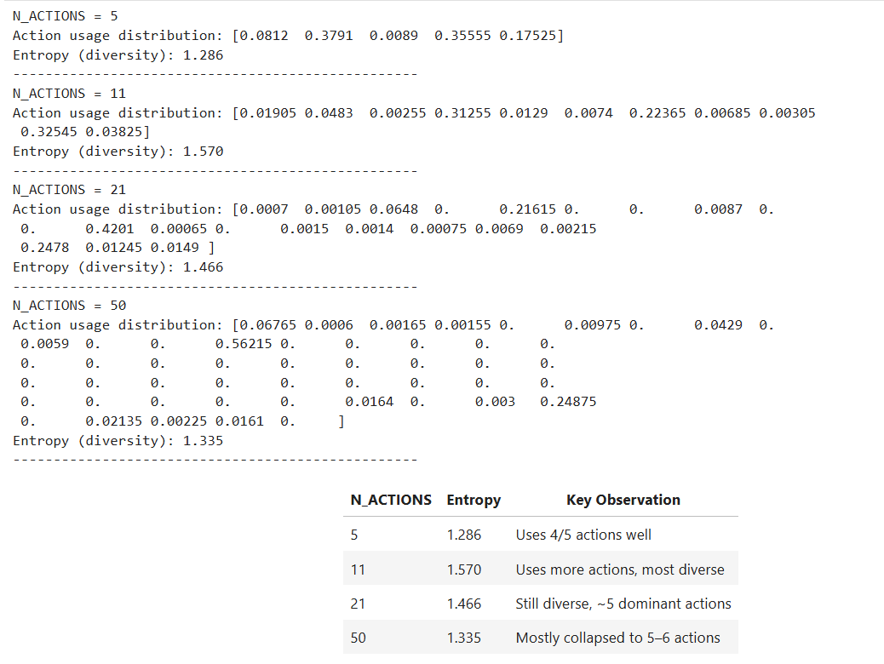
Diagnostic test
With N_ACTIONS = 5, the agent explores and uses nearly all actions meaningfully. The small action space is easier to learn from and requires less data.
At N_ACTIONS = 11, the agent achieves highest entropy, suggesting it can meaningfully differentiate and exploit a richer action set, just needs more training to fully utilise control?
With N_ACTIONS = 21 and especially 50, many actions go unused. The agent collapses to a few actions — not because they're best, but possibly because training was insufficient to distinguish subtle torque differences.

Slide 10
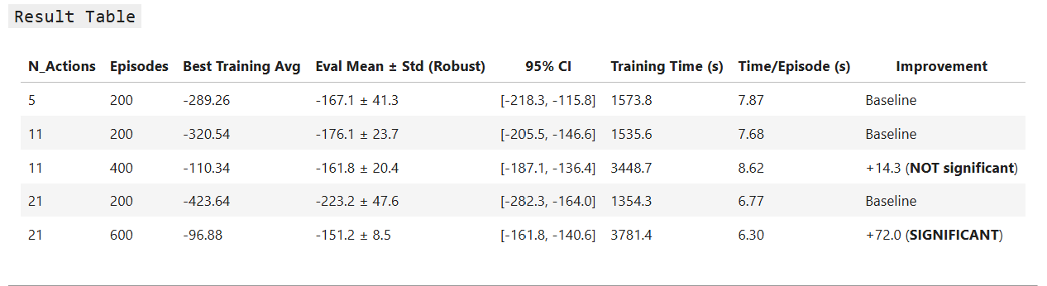
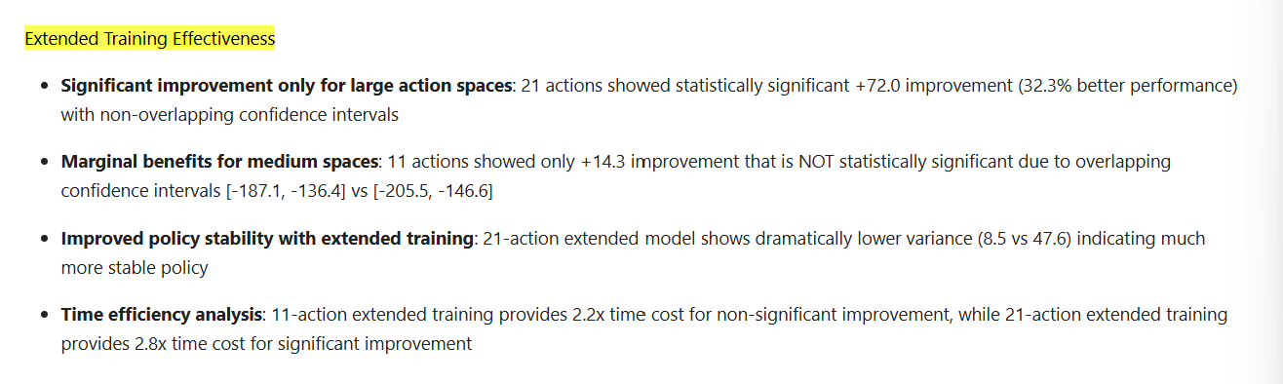
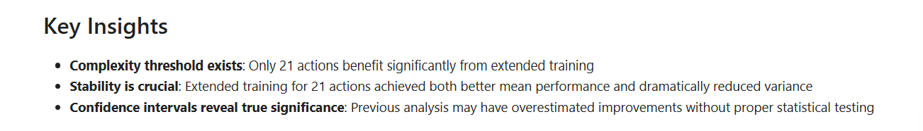
More N_actions = More episodes?

Slide 11
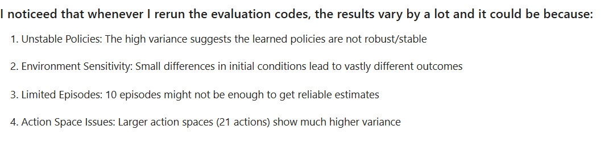
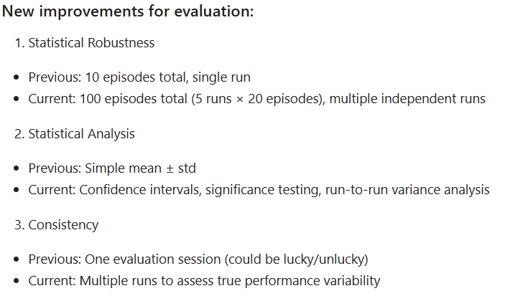
Improvements in codes

Slide 12
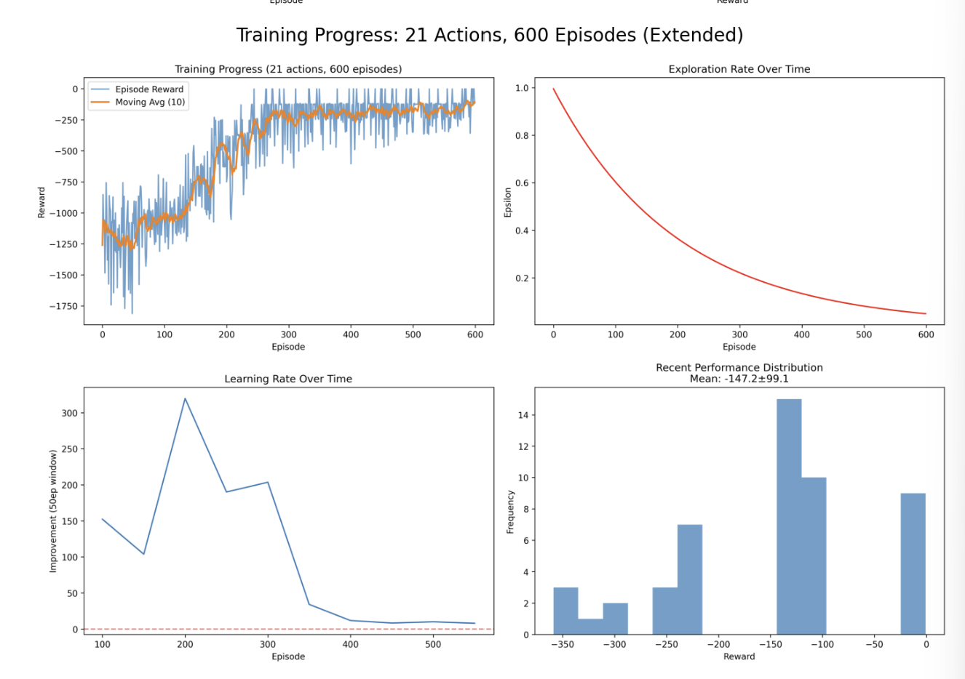
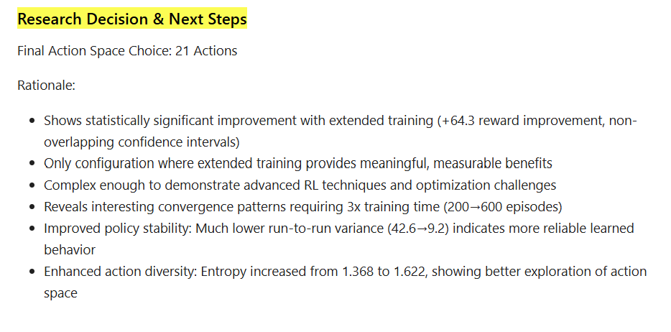
Analysis of 21 Actions (600 eps)
Convergence: Episode ~250-300
Pattern: Steep improvement from episodes 0-250, then plateau around -200 I- nsight: Training could stop at episode 350 - overtraining by ~250 episodes

Slide 13
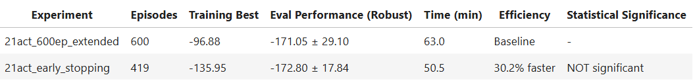
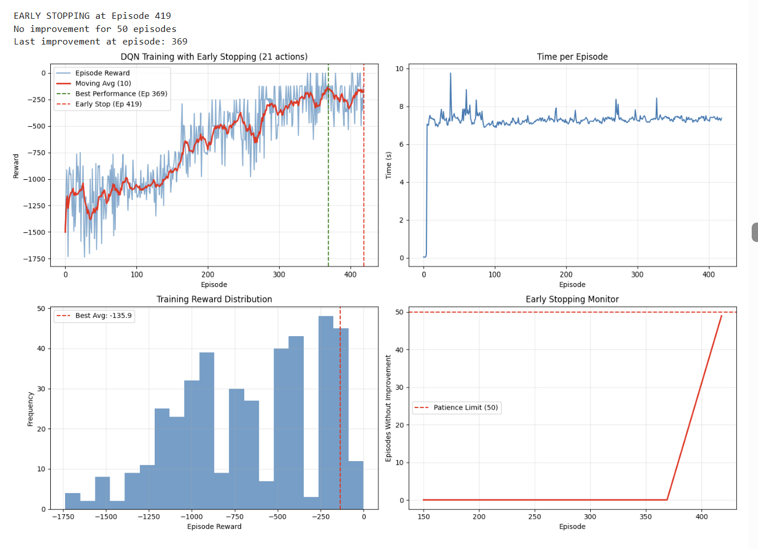
Early stopping?
I would not use early stopping eventhough it seems successfull above but the truth is it causes issues:
Premature Stopping Risk: Early stopping at episode 419 might have prevented the model from reaching the true optimum that was achieved at episode 600
Conservative Approach: In research/production, it's often safer to train longer to ensure convergence rather than risk stopping too early

Slide 14
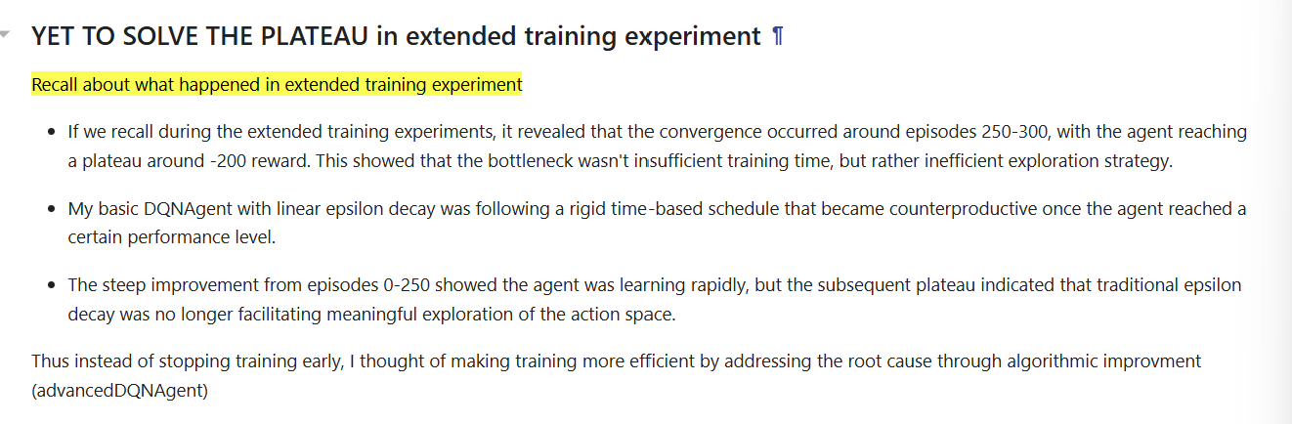
Advanced DQN Agent
AvancedDQNAgent
Implements intelligent stagnation detection that automatically restarts exploration when the agent gets trapped in local optima, directly addressing the convergence issues observed in extended training experiments around episodes 250-300
The plateau restart mechanism specifically targets the stagnation behavior identified in Phase 2, providing strategic exploration boosts that can break through performance barriers that linear decay cannot overcome

Slide 15
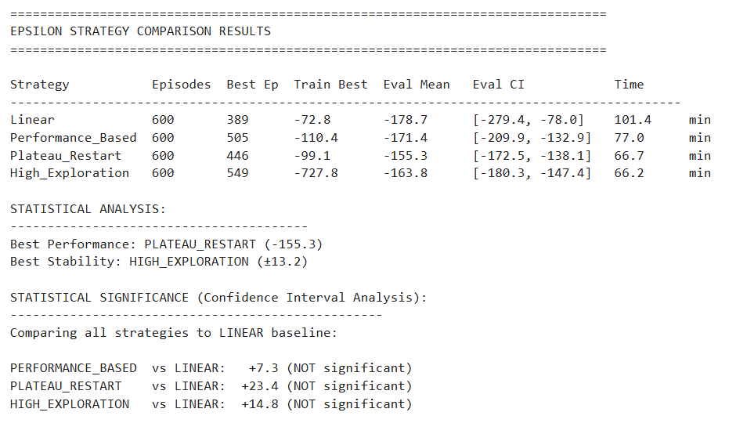
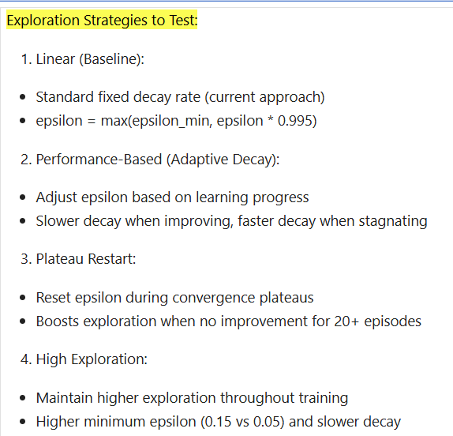
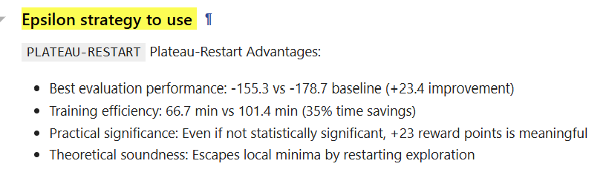
Epsilon Strategy exploration

Slide 16
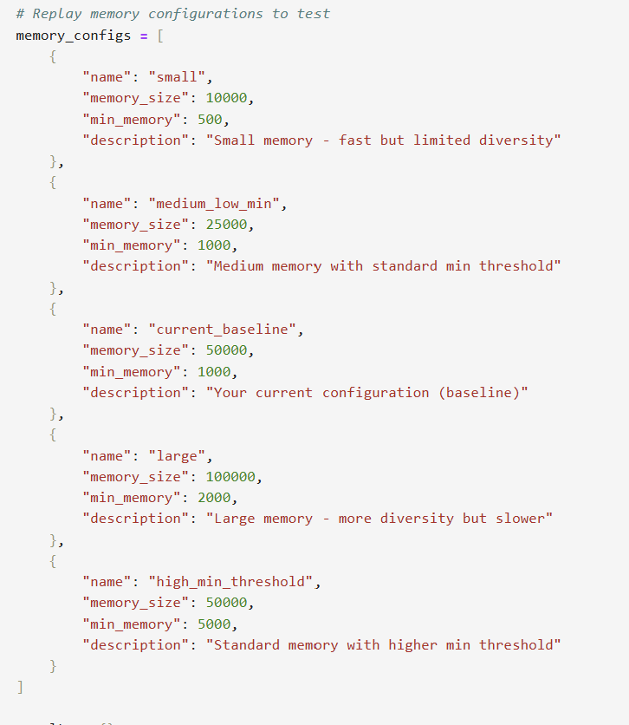
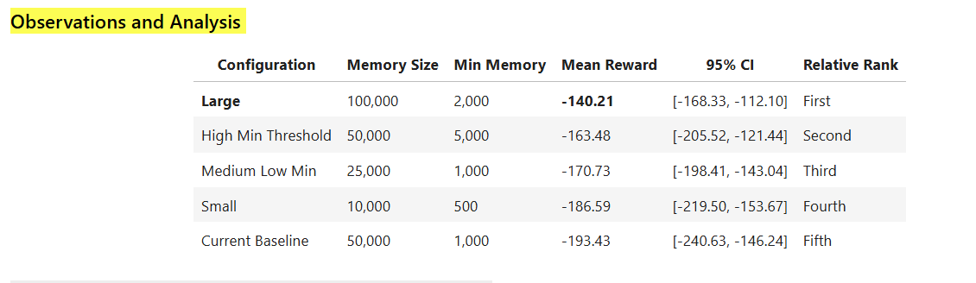
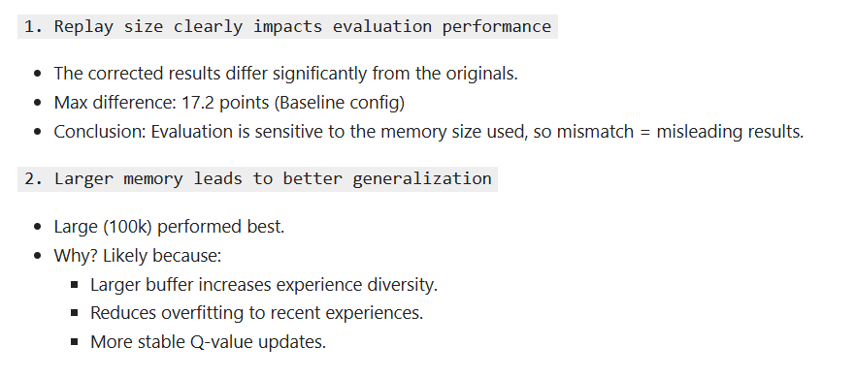
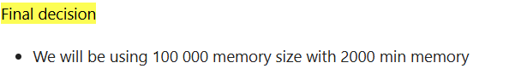
Replay Memory Exploration

Slide 17
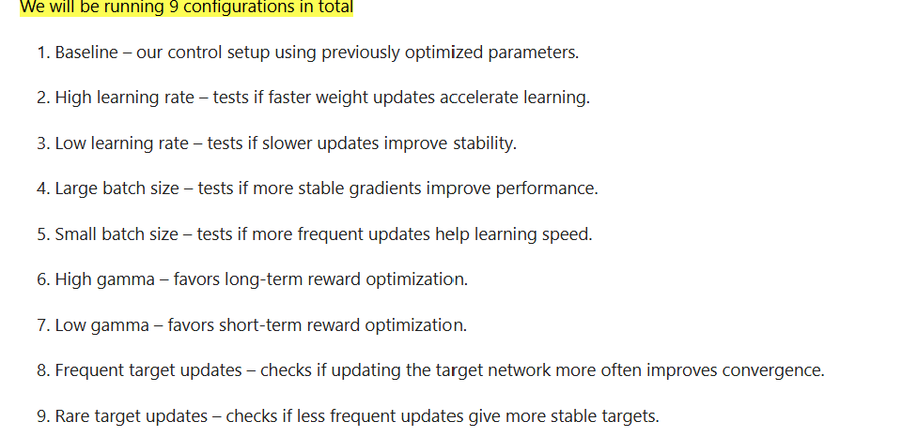
Hyperparameter Tuning
Why we did not run much larger set of configurations?
Computational cost – each run involves 600 episodes of training plus multiple evaluation runs, taking hours per configuration.
Clarity – running too many configs at once makes it harder to trace performance changes to a specific parameter.
Focus – by testing only impactful parameters (learning rate, batch size, gamma, target update frequency) while keeping already-optimized settings fixed (n_actions, memory size, etc.), we maximize the insight per run.

Slide 18
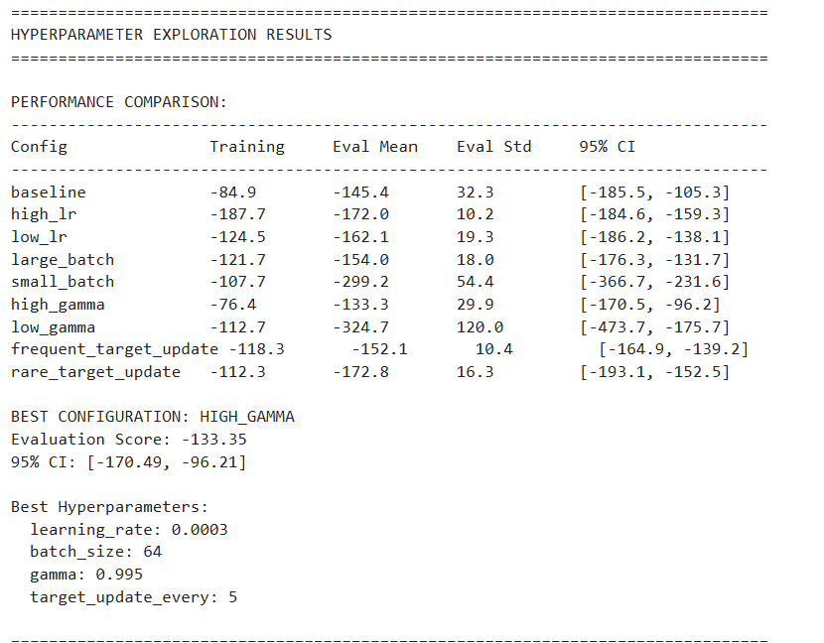
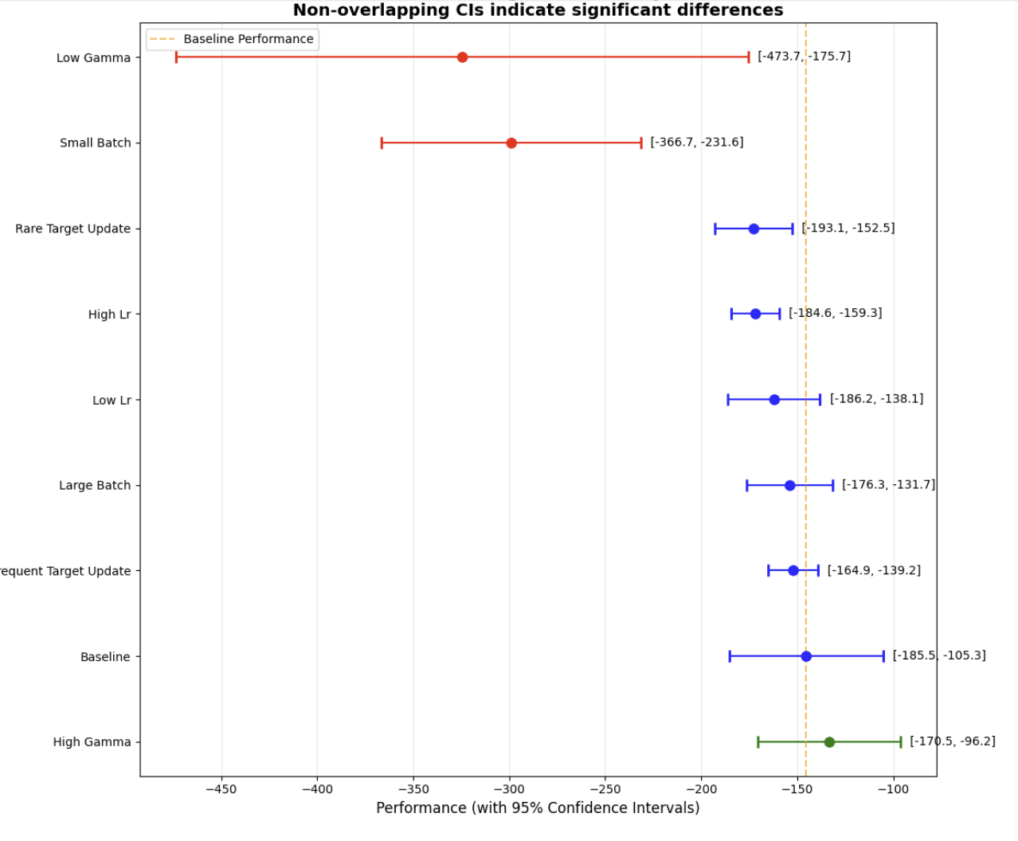
Hyperparameter Tuning (2)
Overtraining Analysis
The Training vs Evaluation plot shows overfitting in some configs — e.g., Low Gamma and Small Batch have relatively better training rewards but much worse evaluation rewards.
High Gamma and Baseline are closer to the "perfect match" line, showing better generalization.
Statistical Significance
Low Gamma and Small Batch have non-overlapping confidence intervals with baseline — meaning their underperformance is statistically significant.
High Gamma overlaps baseline slightly but still trends better.
Most other differences are smaller and could be due to noise.

Slide 19
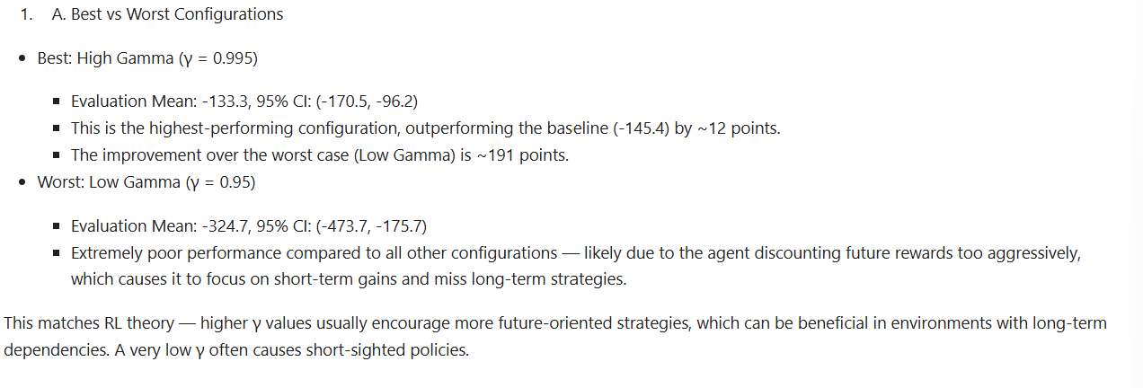
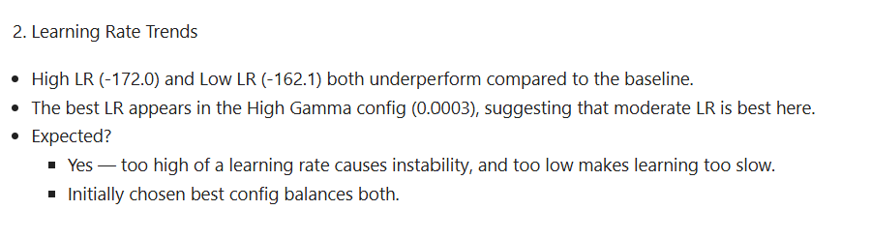
Hyperparameter Tuning (3)

Slide 20
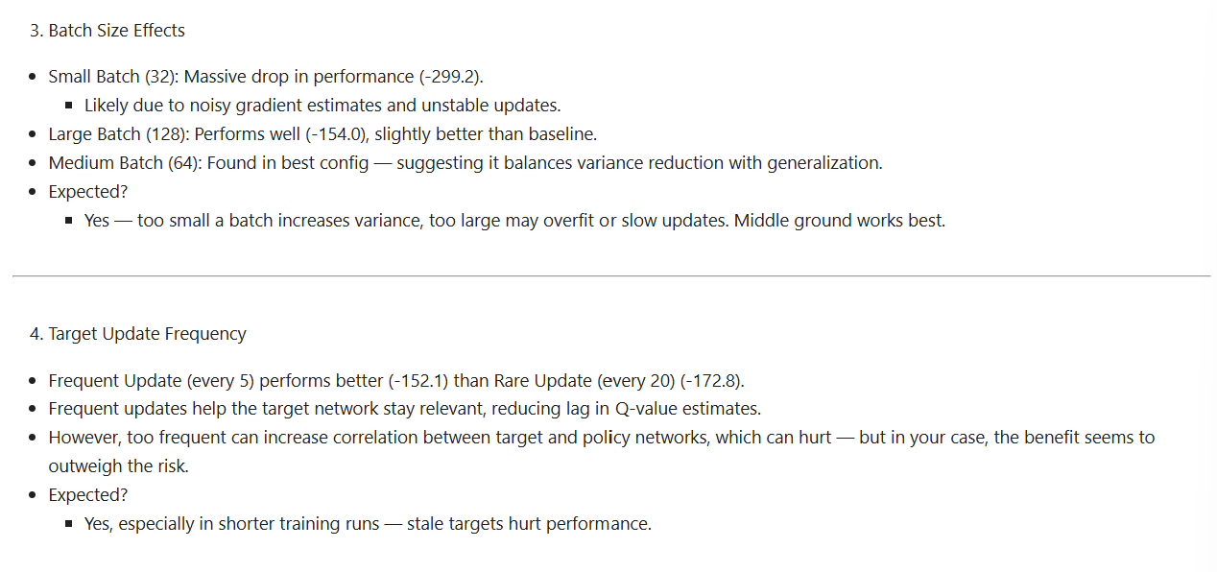
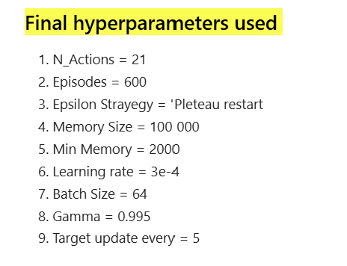
Hyperparameter Tuning (4)

Slide 21
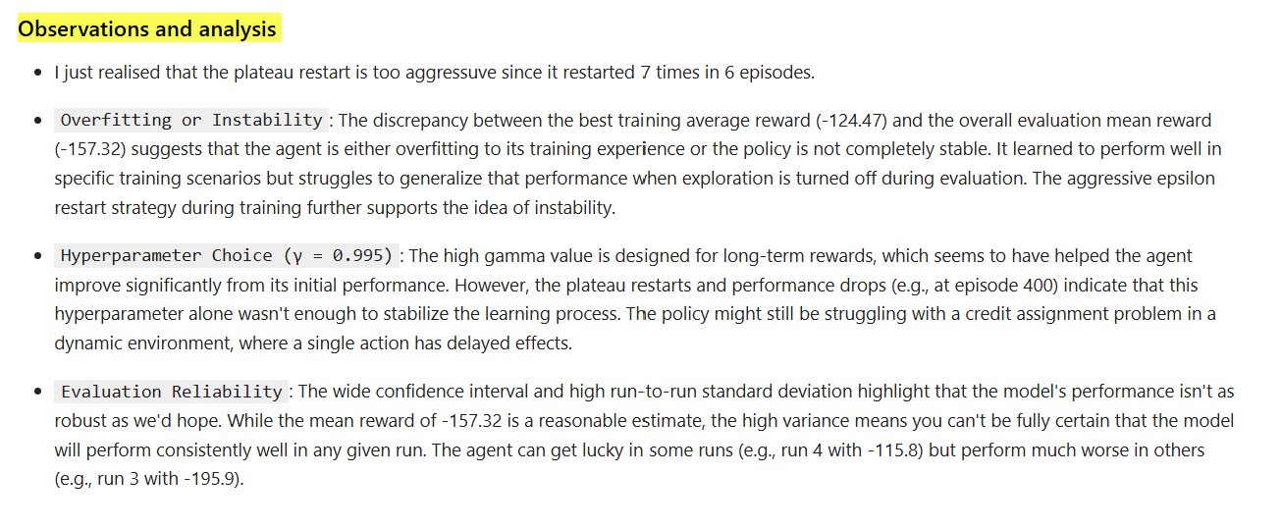
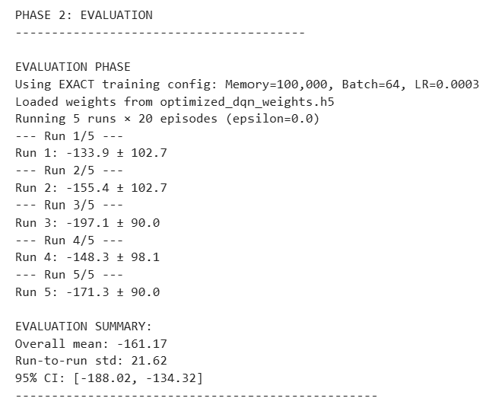
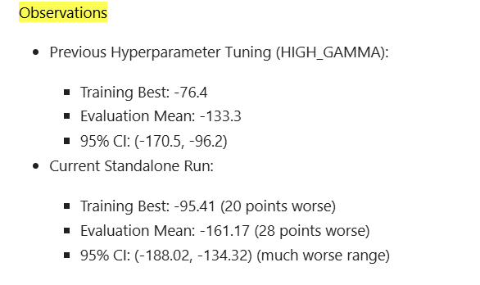
Optimised model
But I wonder isn’t the optimized model supposed to be the best?
WHY DID IT PERFORM WORST THAN HIGH GAMME

Slide 22
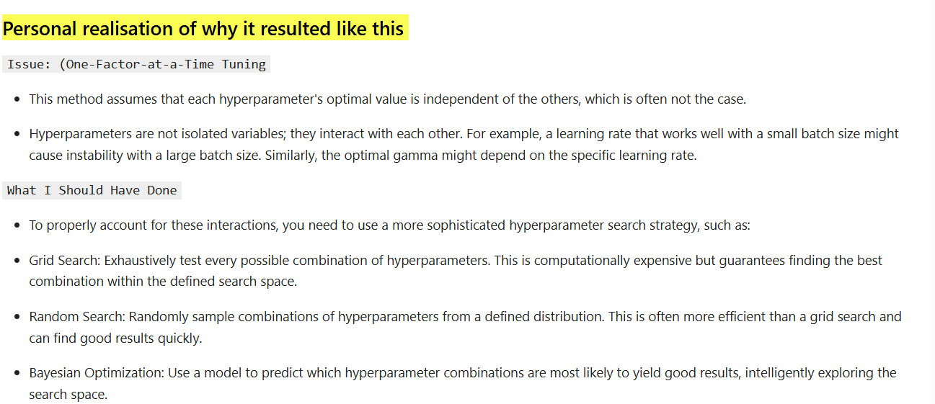
Personal mistakes

Slide 23
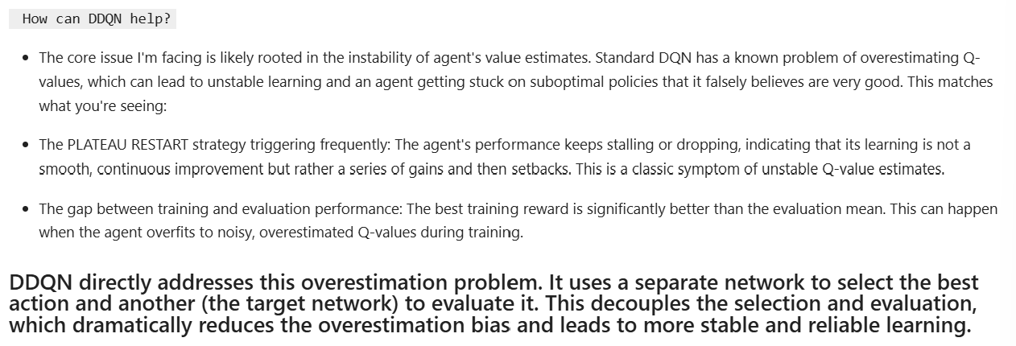
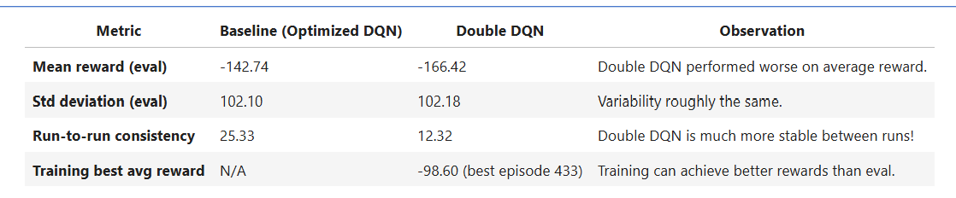
DDQN

Slide 24
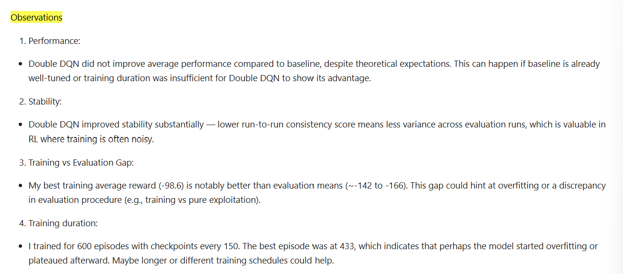
DDQN (2)

Slide 25



DDQN 1000eps (3)

Slide 26


Dueling DDQN

Slide 27




Dueling DDQN (2)

Slide 28


Dueling DDQN vs DDQN

Slide 29



Improved model further (1200eps)

Slide 30



